Slide 1
k.S. institute of technology

Slide 2
ieee - ideathon
PRESENTATED BY
KARTHIK T.C
5TH SEM CSE

Slide 3
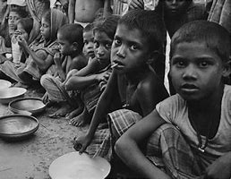
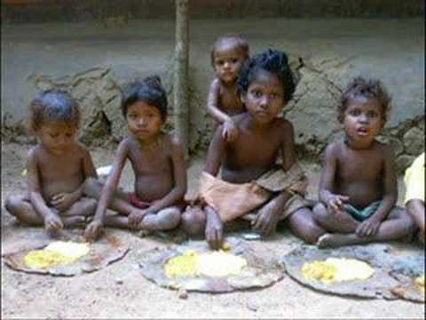
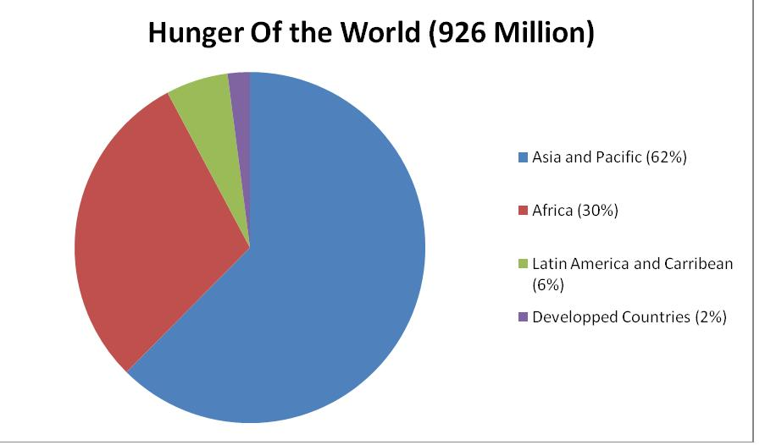
HOW TO END HUNGER GLOBALLY, ESPECIALLY IN INDIA ? SOME FACTS Right Now,1 billion people suffer from hunger.This means that 1 in every 6 people on earth don’t get enough food to live a healthy life.This year 36 million of these people will die of hunger.
194.4 million people i.e. 14.5% of our population is undernourished

Slide 4
I being a computer science student came up with an idea to end this hunger with my application software .
I have an idea of building an application to solve this issues and try to satisfy the hunger of needy through this application. I am creating an interface between the needy( orphanges,old age homes,physically challenged people communities,and the poor slums….) and the donors ,charities ,each and every indiviuals who want to satisfy the hunger of needy. Through this application we can definitely fullfill the hunger of many more…

Slide 5
The main aim of this software ?
To fullfill the hunger of the needy
To reduce the wastage of food in occasions like(marriages,ceremony or in any other events)
To provide better and quality food to the poor
To avoid the scarcity of food

Slide 6
How does this software works ?
This software is to build the communication between the needy and the donor
If the food is needed, then the needy can leave a message in this app regarding his need of food so that message goes to all the users of this application. If anyone has the excess food to donate , then they can provide the needy on time through this app.
In this app we are providing the info and contact details of the orphanges,old age homes,and poor slums which require the food and the user can interact with them and provide the food to them.

Slide 7
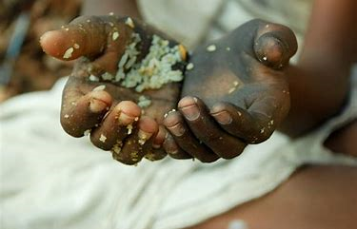
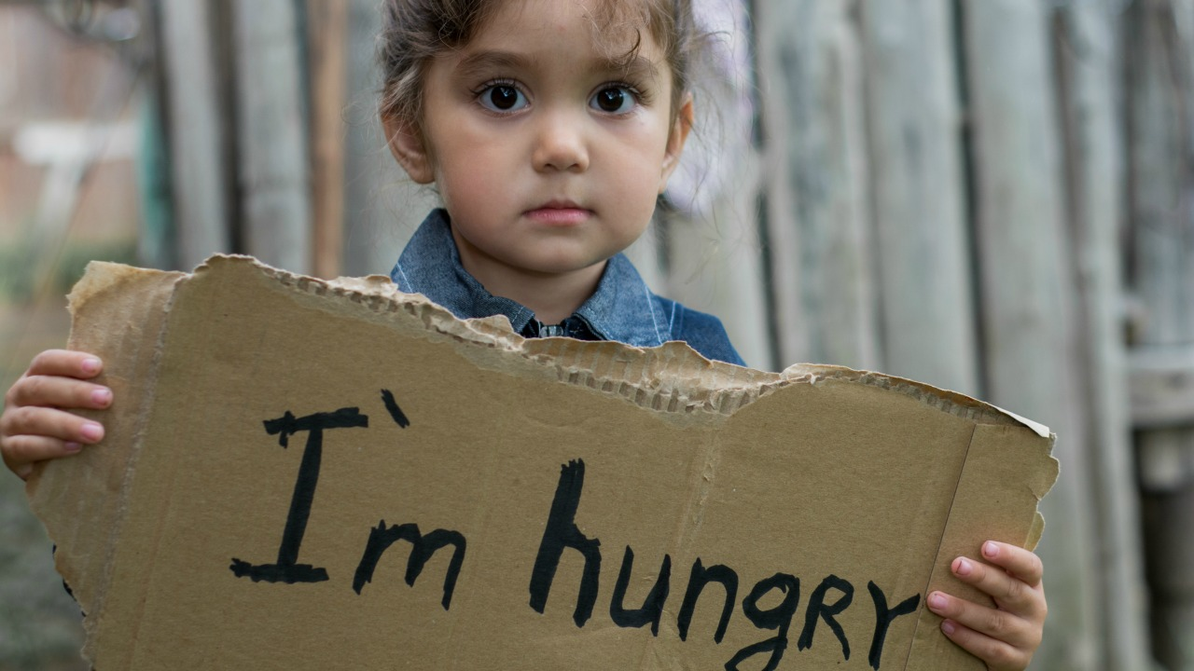
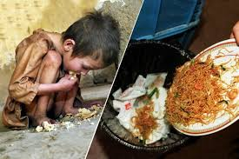
my idea is to fullfill the hunger of the needy and reduce the wastage of food through this app.

Slide 8
Thank you
Together lets end the hunger……

